Slide 1
Please note
IBM’s statements regarding its plans, directions, and intent are subject to change or withdrawal without notice and at IBM’s sole discretion.
Information regarding potential future products is intended to outline our general product direction and it should not be relied on in making a purchasing decision.
The information mentioned regarding potential future products is not a commitment, promise, or legal obligation to deliver any material, code or functionality. Information about potential future products may not be incorporated into any contract.
The development, release, and timing of any future features or functionality described for our products remains at our sole discretion.
Performance is based on measurements and projections using standard IBM benchmarks in a controlled environment. The actual throughput or performance that any user will experience will vary depending upon many factors, including considerations such as the amount of multiprogramming in the user’s job stream, the I/O configuration, the storage configuration, and the workload processed. Therefore, no assurance can be given that an individual user will achieve results similar to those stated here.

Slide 2
Notices and disclaimers
© 2018 International Business Machines Corporation. No part of this document may be reproduced or transmitted in any form without written permission from IBM.
U.S. Government Users Restricted Rights — use, duplication or disclosure restricted by GSA ADP Schedule Contract with IBM.
Information in these presentations (including information relating to products that have not yet been announced by IBM) has been reviewed for accuracy as of the date of initial publication and could include unintentional technical or typographical errors. IBM shall have no responsibility to update this information. This document is distributed “as is” without any warranty, either express or implied. In no event, shall IBM be liable for any damage arising from the use of this information, including but not limited to, loss of data, business interruption, loss of profit or loss of opportunity. IBM products and services are warranted per the terms and conditions of the agreements under which they are provided.
IBM products are manufactured from new parts or new and used parts. In some cases, a product may not be new and may have been previously installed. Regardless, our warranty terms apply.”
Any statements regarding IBM's future direction, intent or product plans are subject to change or withdrawal without notice.
Performance data contained herein was generally obtained in a controlled, isolated environments. Customer examples are presented as illustrations of how those customers have used IBM products and the results they may have achieved. Actual performance, cost, savings or other results in other operating environments may vary.
References in this document to IBM products, programs, or services does not imply that IBM intends to make such products, programs or services available in all countries in which IBM operates or does business.
Workshops, sessions and associated materials may have been prepared by independent session speakers, and do not necessarily reflect the views of IBM. All materials and discussions are provided for informational purposes only, and are neither intended to, nor shall constitute legal or other guidance or advice to any individual participant or their specific situation.
It is the customer’s responsibility to insure its own compliance with legal requirements and to obtain advice of competent legal counsel as to the identification and interpretation of any relevant laws and regulatory requirements that may affect the customer’s business and any actions the customer may need to take to comply with such laws. IBM does not provide legal advice or represent or warrant that its services or products will ensure that the customer follows any law.

Slide 3
Notices and disclaimers continued
Information concerning non-IBM products was obtained from the suppliers of those products, their published announcements or other publicly available sources. IBM has not tested those products about this publication and cannot confirm the accuracy of performance, compatibility or any other claims related to non-IBM products. Questions on the capabilities of non-IBM products should be addressed to the suppliers of those products. IBM does not warrant the quality of any third-party products, or the ability of any such third-party products to interoperate with IBM’s products. IBM expressly disclaims all warranties, expressed or implied, including but not limited to, the implied warranties of merchantability and fitness for a purpose.
The provision of the information contained herein is not intended to, and does not, grant any right or license under any IBM patents, copyrights, trademarks or other intellectual property right.
IBM, the IBM logo, ibm.com and [names of other referenced IBM products and services used in the presentation] are trademarks of International Business Machines Corporation, registered in many jurisdictions worldwide. Other product and service names might be trademarks of IBM or other companies. A current list of IBM trademarks is available on the Web at “Copyright and trademark information” at: www.ibm.com/legal/copytrade.shtml.

Slide 4
7461 Hands on Lab: Add Intelligence to Business Automation with IBM Business Automation Insights — Sebastian Carbajales IBM Digital Business Workflow, Architecture & Development Christophe Jolif IBM Digital Business Automation, Architecture & Development

Slide 5
Contents
Lab Goals
What is Business Automation Workflow?
What is Business Automation Insights?
Lab Overview

Slide 6
Lab Goals
Have fun
Feel free to divert from the instructions and experiment
Learn
How to work with data in the IBM Business Automation Insights data lake
How to use Jupyter notebook to train and deploy a machine learning model to an IBM Watson Machine Learning service instance
How to call the deployed model from IBM Business Automation Workflow

Slide 7
What is Business Automation Workflow (BAW)?

Slide 8
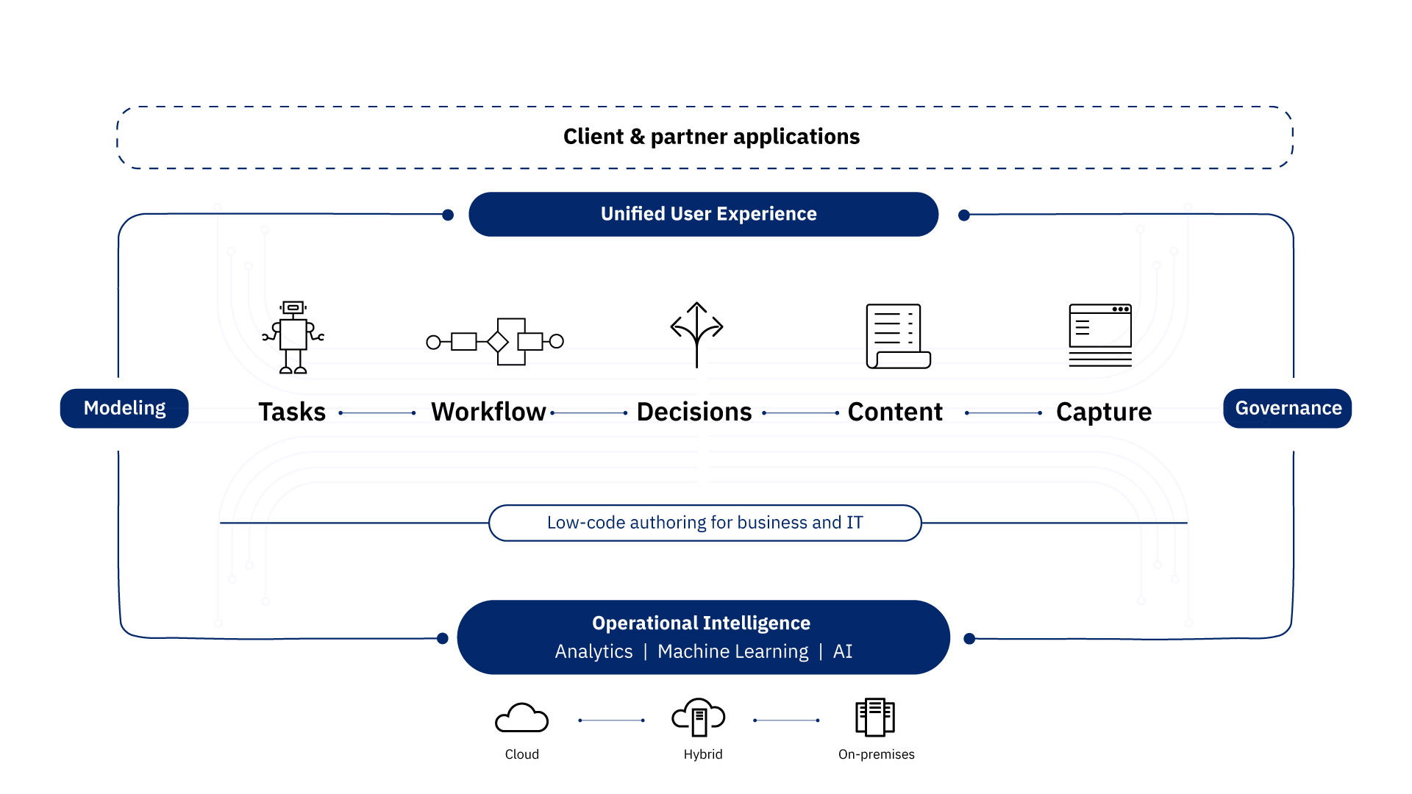

IBM Automation Platform for Digital Business

Slide 9


IBM Business Automation Workflow
IBM Digital Business Automation
IBM Case Manger
IBM Business Process Manager
+

Slide 10



Workflow - Combining Process and Case
Spectrum of digital work patterns
Unordered collection of data, content, participants, structured and unstructured activities
Ordered Sequence
of Activities
Some Unordered
(Ad-hoc) Activities
Some Activities
with Ordered Steps
Case 123
Process Centric
Process Model
Driven Outcomes
Case Centric
Knowledge Worker
Driven Outcomes
Any of these patterns can the entry point for creating solutions that solve business problems
Each pattern can also be built on or combined with the others to create more robust solutions
Think 2019 / 7461 / Feb 15, 2019 / © 2019 IBM Corporation
Notes:
A single IBM Workflow offering combining IBM BPM and IBM Case Manager
ICM will leverage IBPM for its embedded taskflow engine and authoring tools
Provides a common technology platform and process asset investment
IBPM will gain full ECM content and case awareness
Ability to attach, manipulate metadata, respond to events
IBPM will provide direct integration with ICM when case style workloads are needed
Knowledge and task workers will have an unified view of all their work
Like Case Manager solutions, IBPM applications can include rapidly assembled and customized user interfaces that go beyond process step views

Slide 11
What is Business Automation Insights (BAI)?

Slide 12
What is Business Automation Insights?
« Business Automation Insights is a DBA platform-level capability which provides 360° view of their operations to business owners, and feeds a data lake to enable infusing artificial intelligence for automated solutions »
Guided Work
Dashboards
Data Storages
Collect and aggregate operational data
Visualize and monitor operations
Learn , predict and recommend
Siloed Data
Business Automation Insight

Slide 13
Business Operation Data
Tasks
Content
Workflow
Capture
Decisions
Content-level and productivity data that bots generate
Content lifecycle management data like Content events, user interactions with content etc.
Processes & cases data, humans/system task data and user interactions
Data extracted from documents
Rules in place, decision inputs, outcomes
What kind of data?
RPA
ECM
BAW
Datacap
ODM

Slide 14
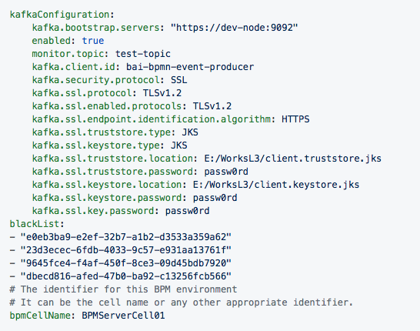
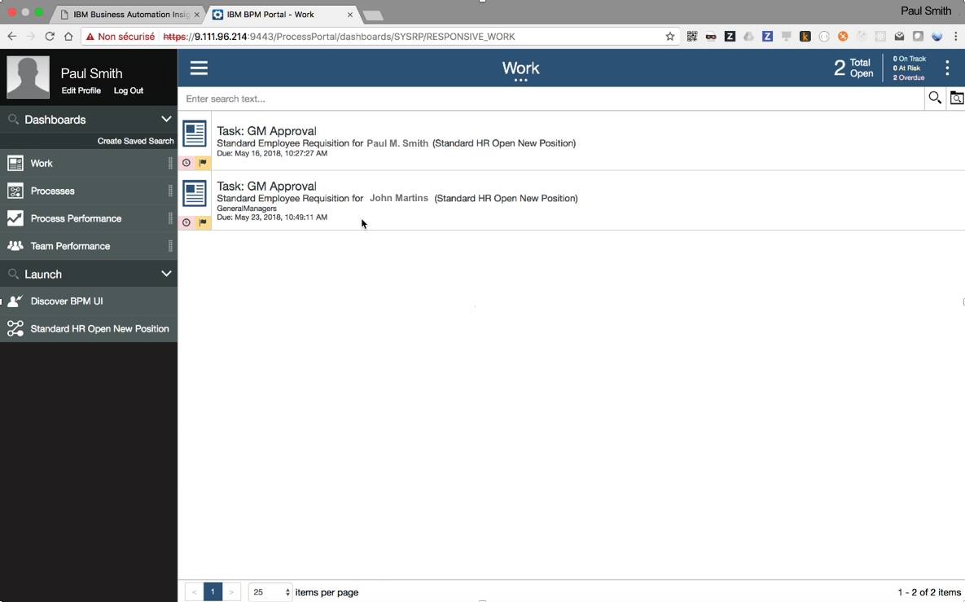
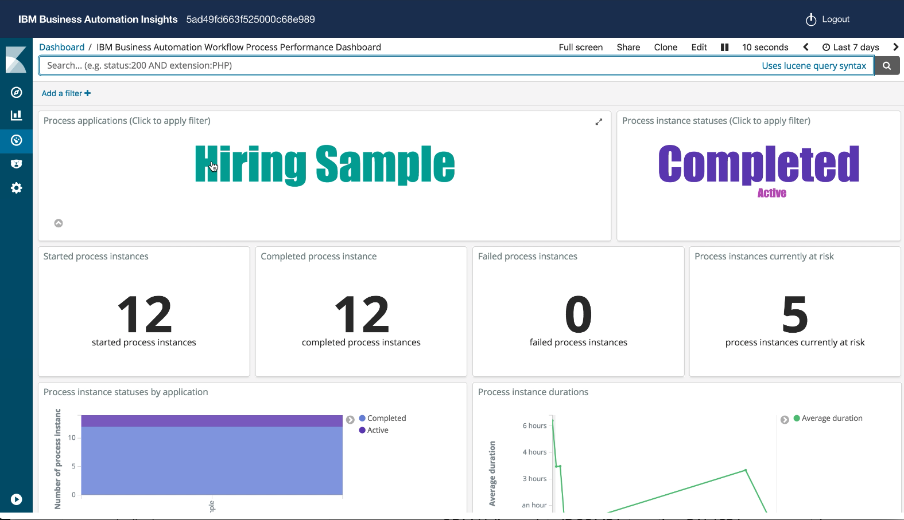
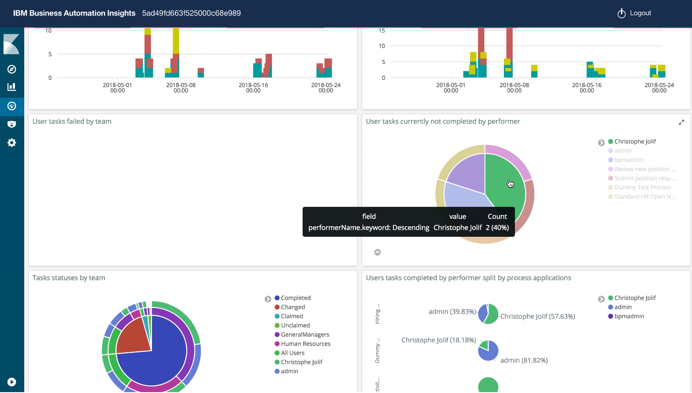
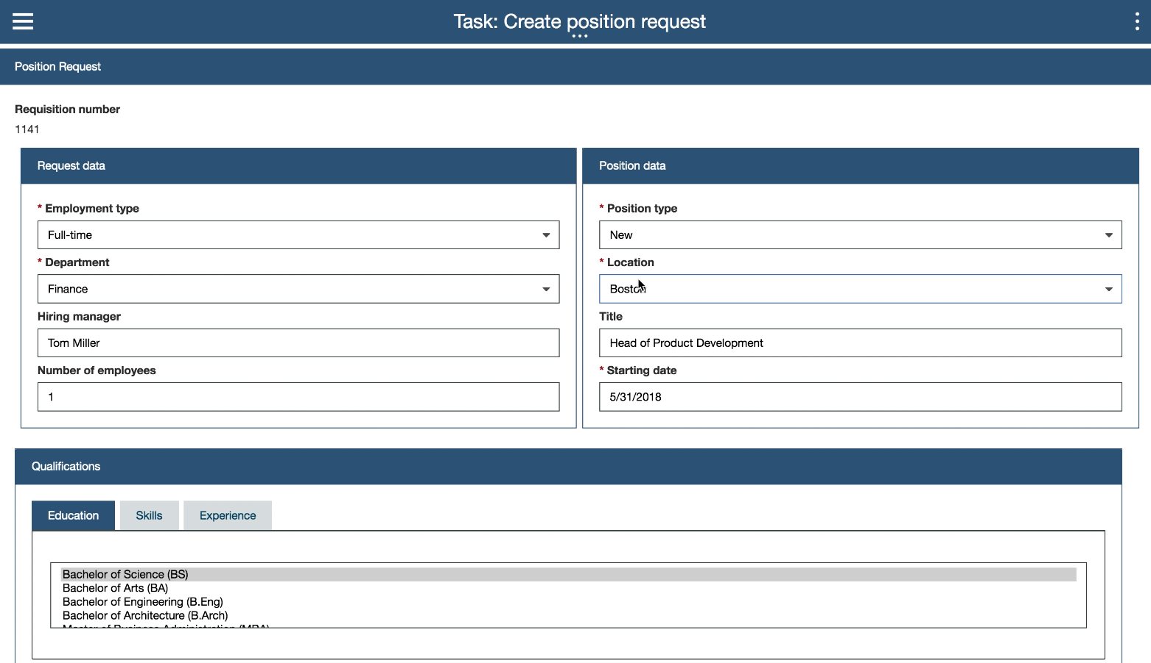
From Operational Insights Analysis to …
« visualization insights »
Setup Emitter
Start Workflow
Monitor in BAI
Configuration files
BPM Portal
Kibana - BAI User Interface
Emitter
Data Storage (Elasticsearch)
…
New instance

Slide 15
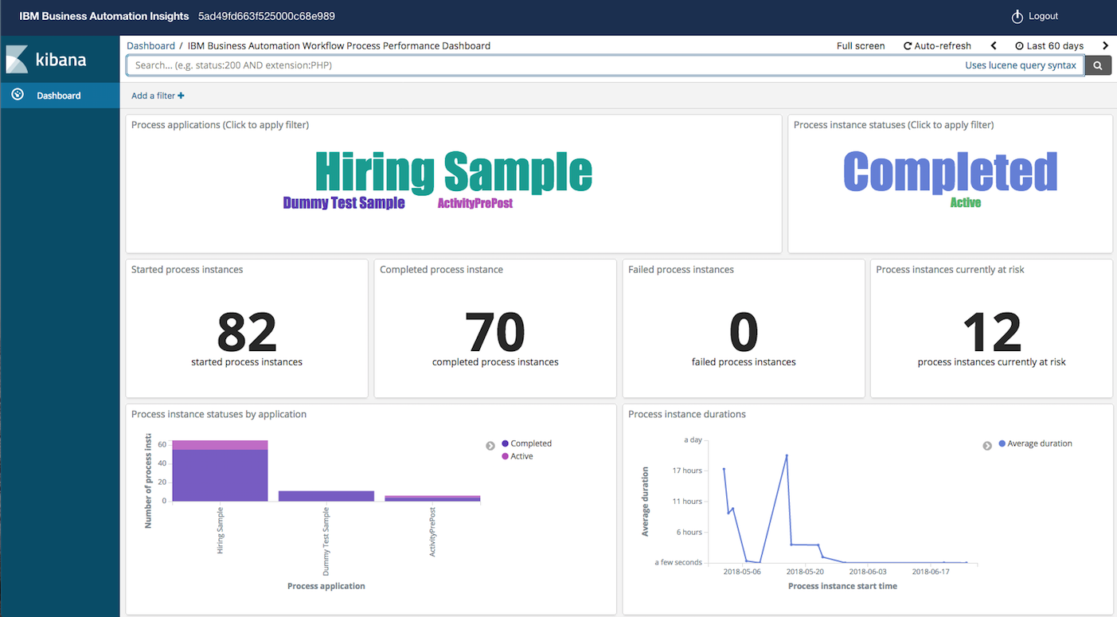
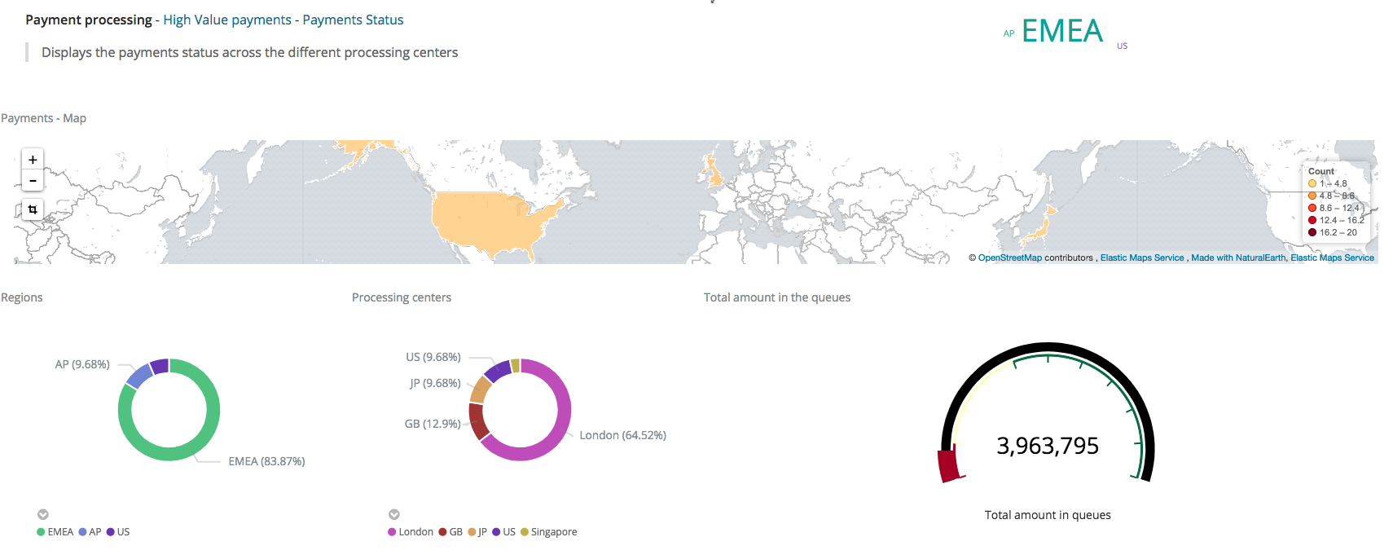
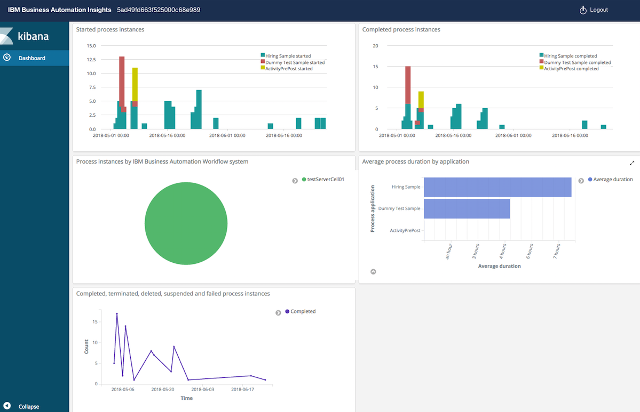
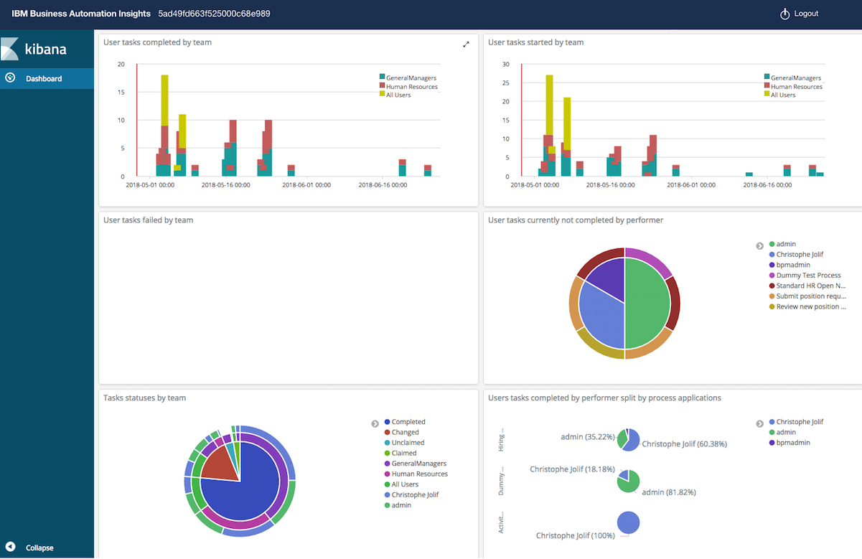
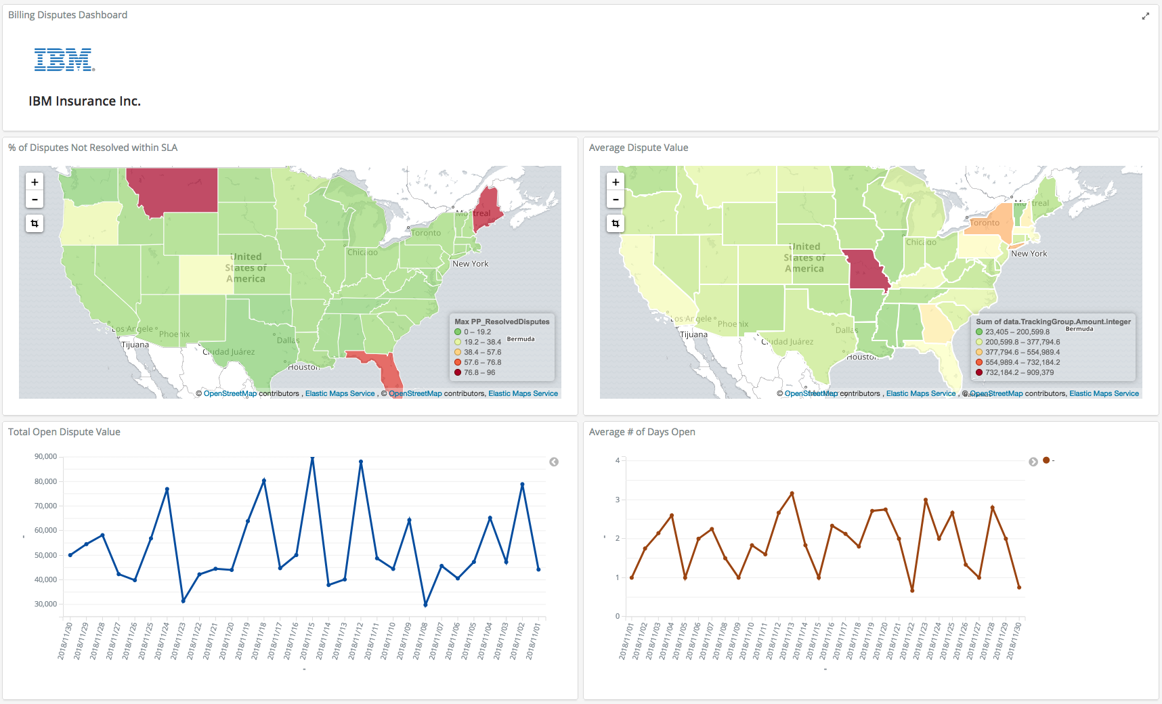
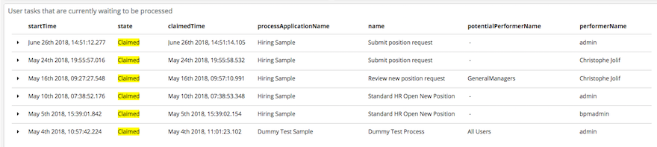
Examples of Out of the Box and Custom Dashboards

Slide 16
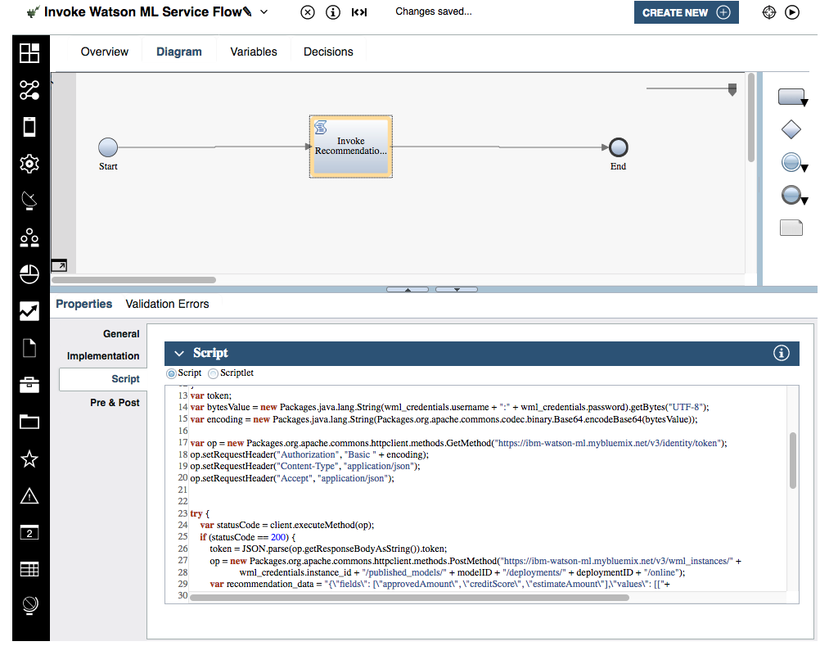
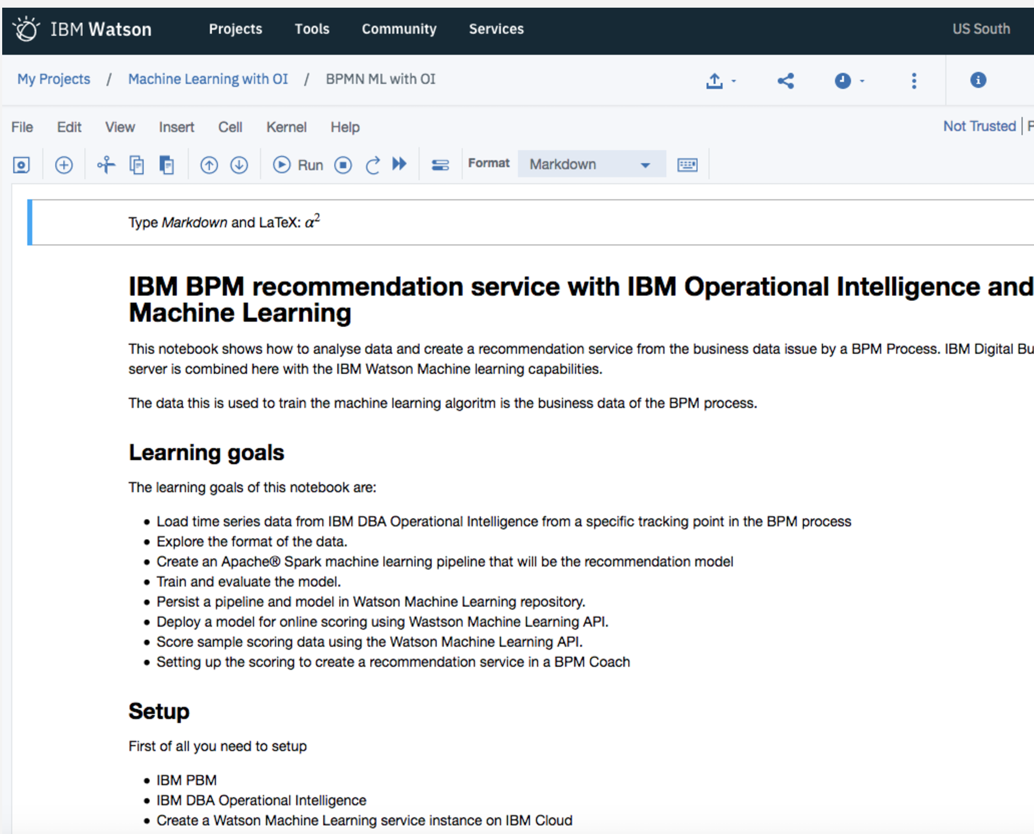
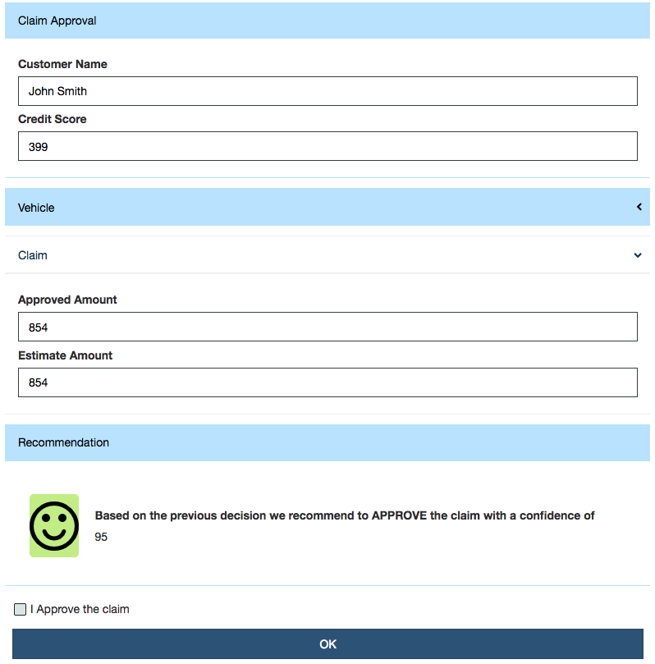
… to Machine Learning Recommendations
« infuse artificial intelligence »
Leverage Data
Machine Learning
DBA
Process Designer
IBM Watson Studio
Invoke ML Recommendation
Watson Studio Notebook
(Sample)
ML Models
(Samples)
+ =
Data Storage (HDFS)
…

Slide 17

High Level Architecture
Anonymization
Rules
BPMN Emitters
BAI Query & Dashboard Storage*
BAI Dashboards (use, create, share)
Case Emitters
IBM Event Streams*
BAI Data Ingestion & Processing
Long Term Storage
IBM Watson Studio / DSX
ODM Emitters

Slide 18
Business Automation Insights Takeaways
Collect
Scalable capability to capture end to end business data from different instances of DBA platform components into a data lake.
Visualize
Provides real-time visibility to Business Managers via pre-defined or user configured dashboards.
Learn & Guide
Enable Data Scientists to apply MLs on the operational data lake to make recommendations to business

Slide 19
Lab Overview

Slide 20
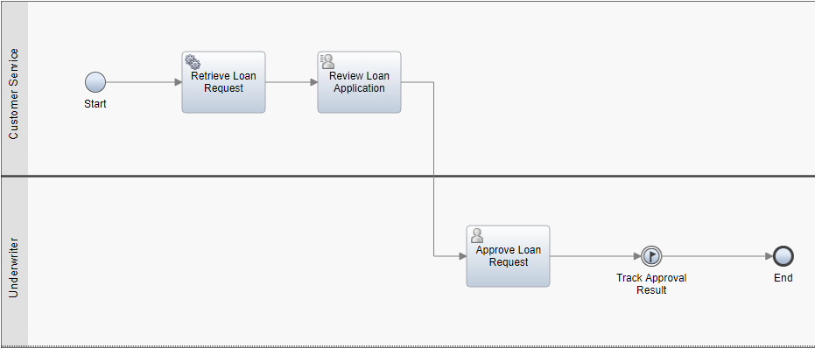
Lab Scenario
Leverage BAI data to train and deploy a machine learning model that will provide a recommendation for a decision in a business process
IBM Automation Platform for Digital Business
IBM Cloud
IBM Business Automation Workflow
IBM Watson Machine Learning Service
5
4
IBM Watson Studio Notebook
Read data from IBM Business Automation Insights
Prepare data
Train ML model (Spark ML)
Deploy and publish model in IBM Watson ML Service
1
IBM Business Automation Insights
2
3
Data Lake
(HDFS)

Slide 21
Lab Structure
Section 1 [BAW]:
Explore and understand how the Car Loan Approval process works
Section 2 [notebook]:
Load the BAI data from HDFS
Explore the format of the data and interpret it
Create an Apache® Spark machine learning model
Store and deploy the model in Watson ML
Test the deployed model
Section 3 [BAW]:
Modify the Car Loan Approval process to call the deployed model for a given loan
Display the recommendation to the user

Slide 22
Thank you
Sebastian Carbajales, IBM Digital Business Workflow, Architecture & Development, sebastia@ca.ibm.com
Christophe Jolif, IBM Digital Business Automation, Architecture & Development, christophe.jolif@fr.ibm.com

Slide 23
®

